Slide 1
I AM PATHO
Team:-
1. Harshal Faldu
2. Manharsinh Jadeja
3. Jay Solanki
4. Josh Trivedi
5. Janvi Davda
Mentor:-
Prof. Mehul Kantaria

Slide 2
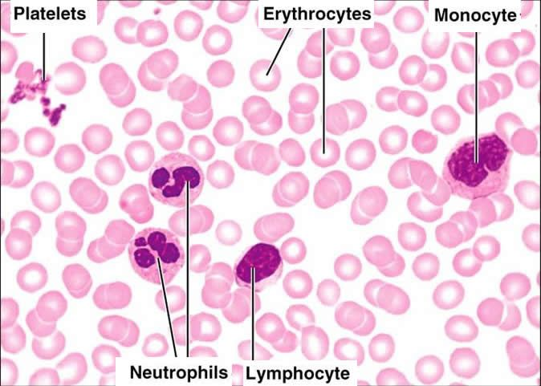
Solution
Mobile phone
Blood slides
Application
Disease diagnose

Slide 3
Implemented till Yet
Algorithm to count RBC and WBC
Algorithm to find size of nucleus in cell
Android app which can take image of blood slide
Structure of hardware (*On AutoDesk)

Slide 4
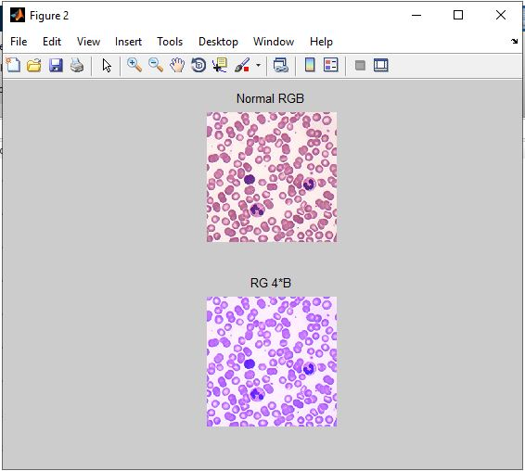
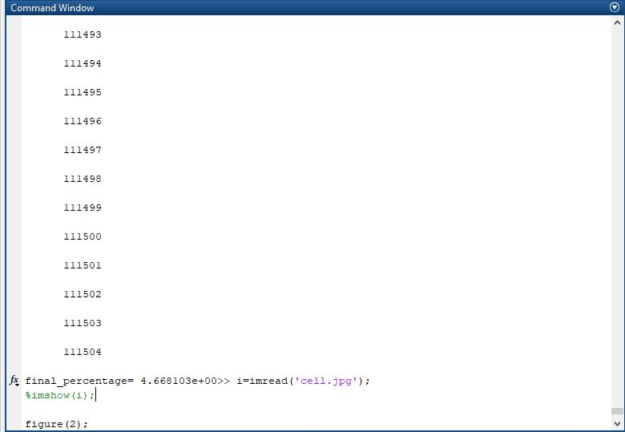
Algorithm To Find Size Of Nucleus In Cell

Slide 5
Limitation of Foldscope
Can't getting proper zooming
More Frequent lens is not available
For consistency need stable hardware

Slide 6
Structure of Hardware
On Paper

Slide 7
Continue..
On AutoDesk

Slide 8
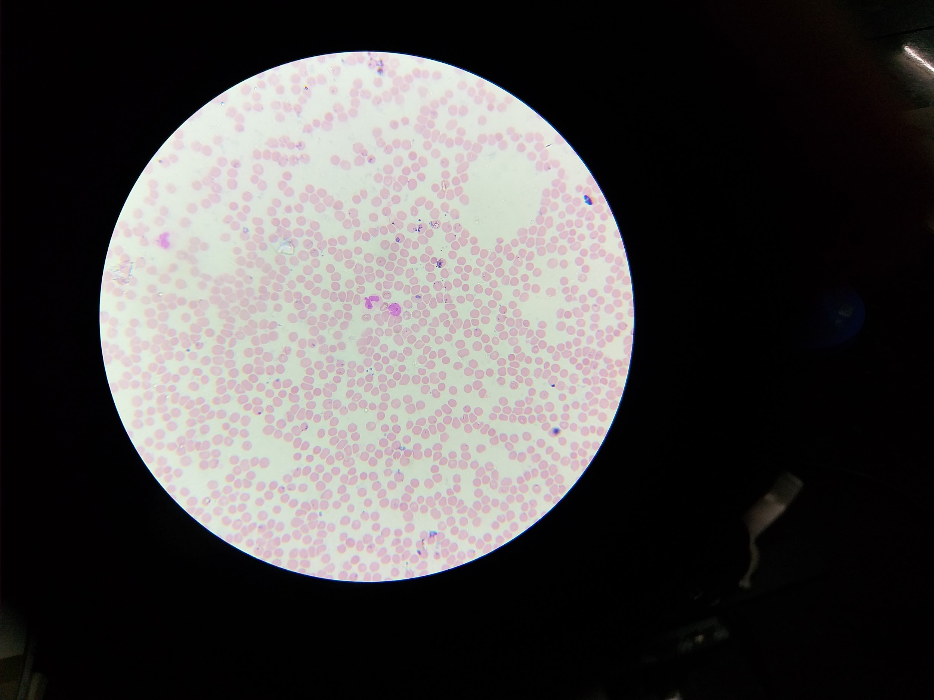
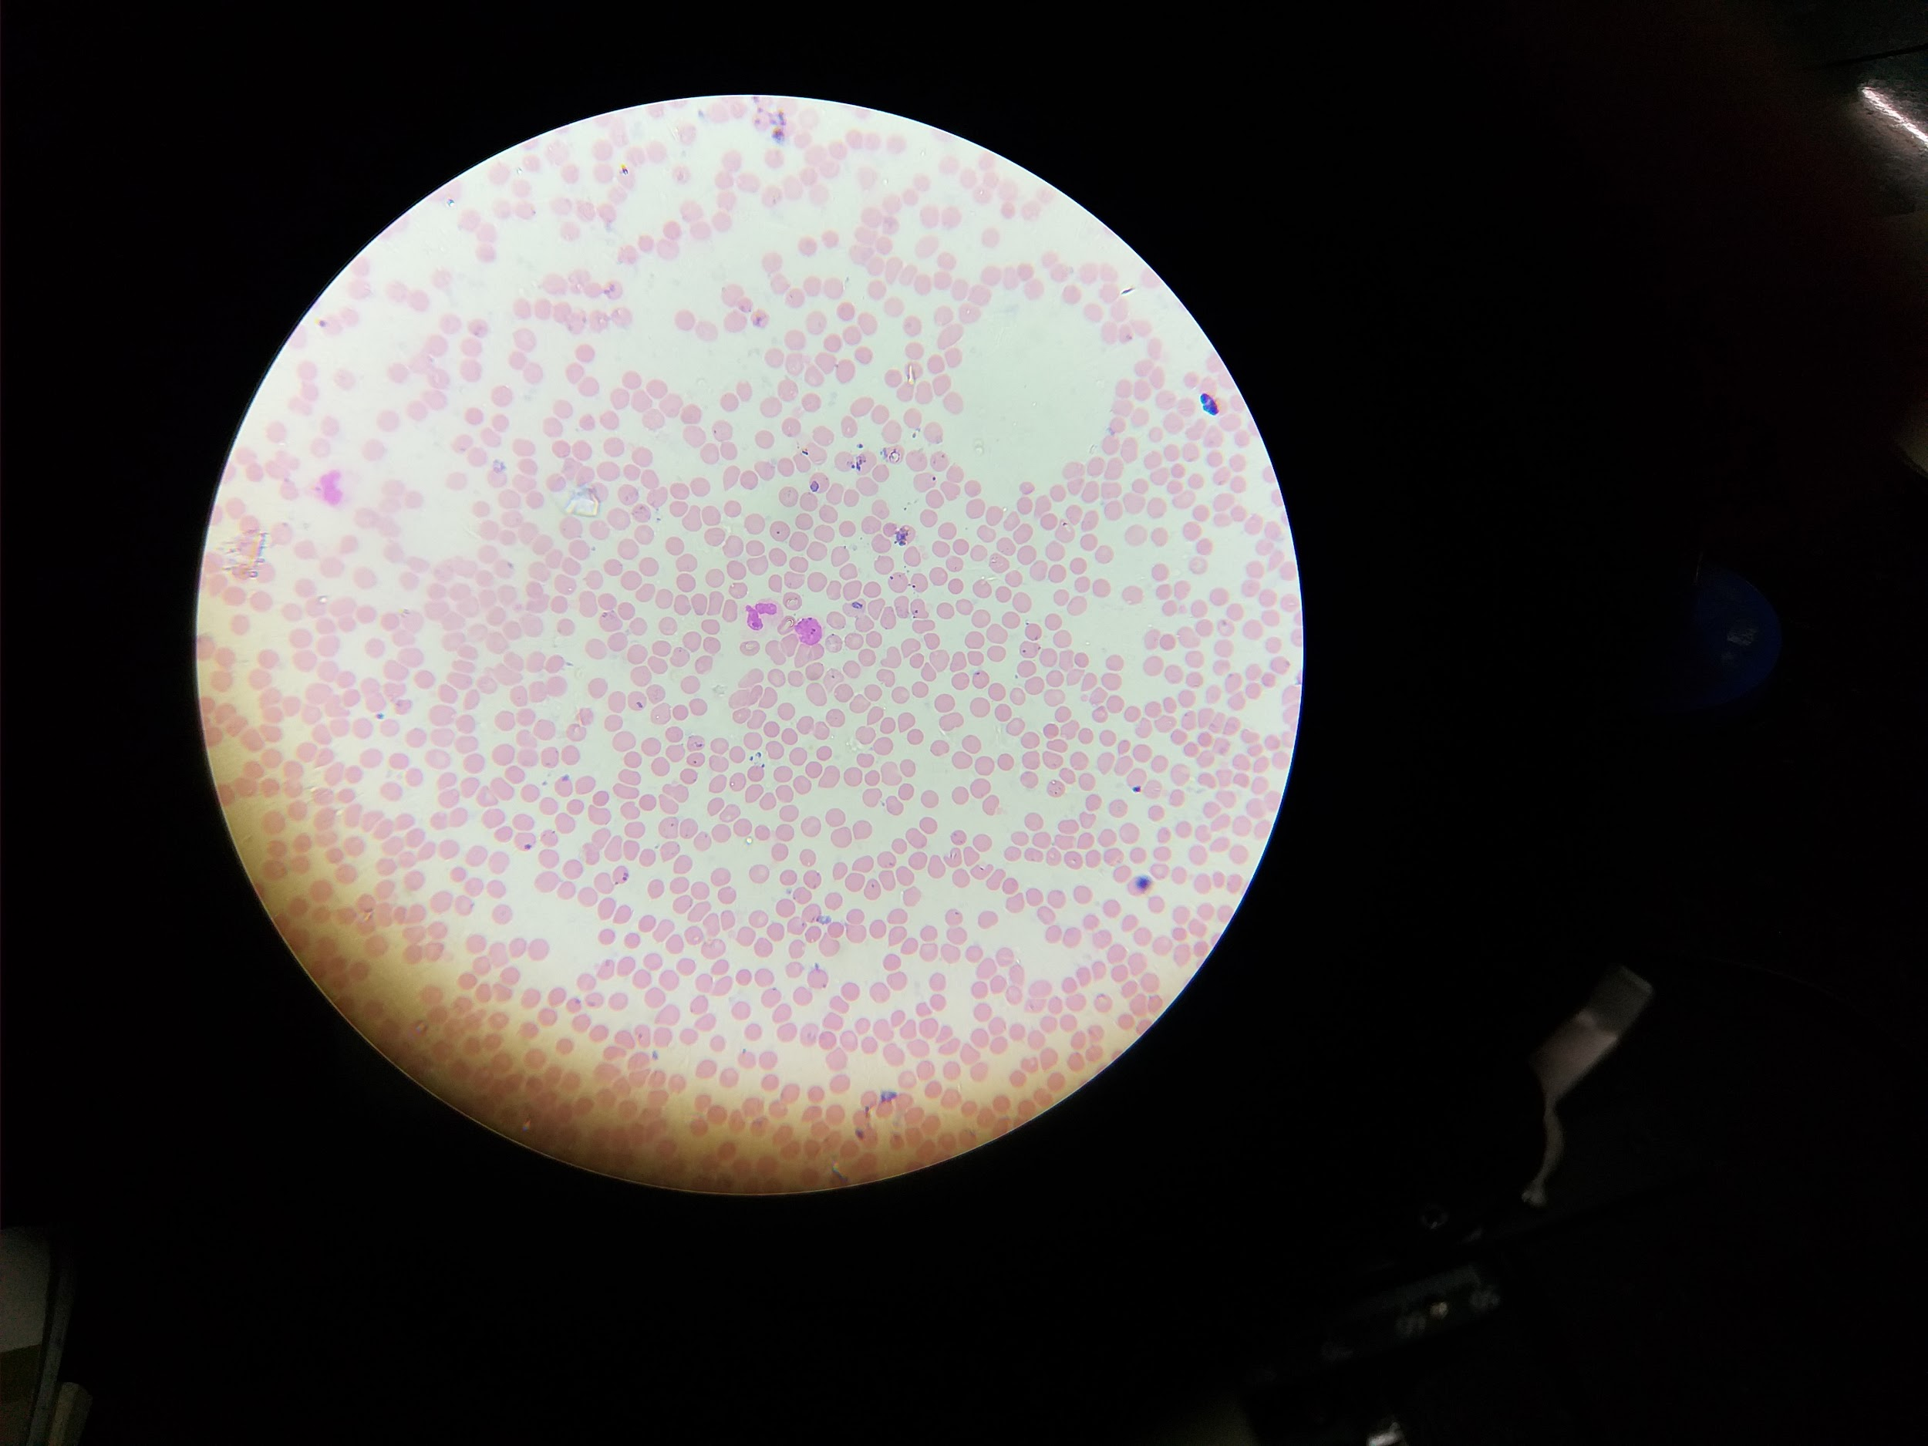
Tested Output References for Hardware

Slide 9
Problem Facing In Software
Facing error while integrating matlab and android
Due to inner matlab processing may server take load
Storage Capacity of server may affect in process
Solution: Cloud Integration

Slide 10
Funding So Far
1047 -/RS for Foldscope
Currently we are working on software part and research part so we haven't utilize more fund

Slide 11
Future Plans
Integration with cloud
Real time testing of algorithm
Validation of results by experts

Slide 12
Submitted Financials Details
The Bifurcation for the financial supports is given as:
Medical Consultancy Charge Rs. 15,000
Product Development Cost: Rs. 60,000
Raw materials Rs. 13,000
Miscellaneous Cost: Rs. 15,000
Total Estimated Cost: Rs. 103,000

Slide 13
Refrences
https://www.amazon.in/Beileshi-60x-100x-Microscope-Magnifier-Universal/dp/B07GC331QT/ref=sr_1_27?keywords=microscope+lens+100x+with+phone&qid=1562241308&s=gateway&sr=8-27
https://www.google.com/search?q=blood+slide&client=firefox-b-d&tbm=isch&source=iu&ictx=1&fir=1IrcIzgGQf1wUM%253A%252C74QRchcW6oYCZM%252C_&vet=1&usg=AI4_-kRFosQaw_7ZTMafzMfd9b364Q_AvQ&sa=X&ved=2ahUKEwizwsrdmpvjAhURheYKHWEFDe4Q9QEwAHoECAIQBA#imgrc=1IrcIzgGQf1wUM:
https://www.bing.com/images/search?q=app+development&qs=CustomSearch&pq=app+deve&sc=8-8&cvid=811E84312C1F414A82952294E6ADF7AE&sp=2&form=QBIR
https://appbodia.com/best-smartphone-microscope/
https://www.bing.com/images/search?q=maarketing%20plan&cbir=sbi&imageBin=&qs=n&form=QBIR&sp=-1&pq=maarketing%20plan&sc=8-15&sk=&cvid=C77924CA53D64361BEA113CAE009BFB6

Slide 14
?

Slide 15
Thank you

